Slide 1
Lead Score Case Study
Submitted By: Amandeep Chhabra
Rishi Garhwal

Slide 2
Problem Statement
X Education sells online courses to industry professionals.
X Education gets a lot of leads, its lead conversion rate is very poor. For example, if, say, they acquire 100 leads in a day, only about 30 of them are converted.
In order to increase the lead conversion rate, the company first should identify the most potential leads, also known as ‘Hot Leads’.
If they successfully identify this set of leads, the lead conversion rate should go up as the sales team will now be focusing more on communicating with the potential leads rather than making calls to everyone.

Slide 3
Business Objective:
X education wants to know the most promising leads.
For that, they want to build a model which identifies the hot leads.
Deployment of the model for future use.

Slide 4
Strategy
Import Data
Clean and prepare the acquired data for further analysis
Exploratory data analysis for figuring out the most helpful attributes for conversion
Scaling features
Prepare the data for model building
Build a logistic regression model
Assign a lead score for each lead
Test the model on the train set
Evaluate the model by different measures and metrices
Test the model on test set
Measure the accuracy of the model and other metrics for evaluation.

Slide 5
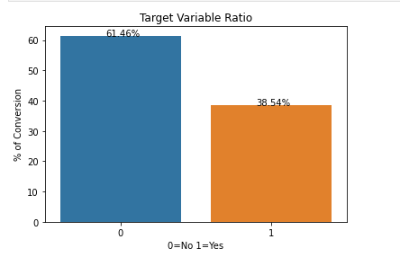
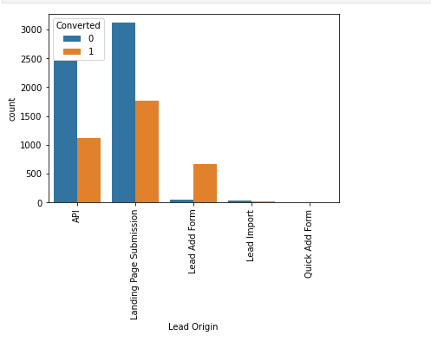
DATA VISUALISATION

Slide 6
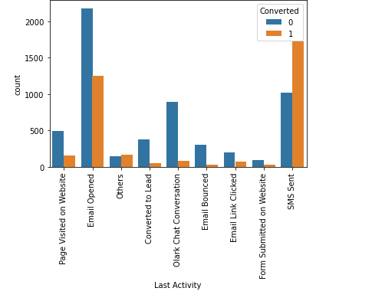
TARGET VARIABLE ON LAST ACTIVITY

Slide 7
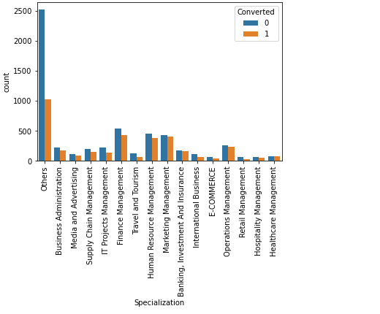
TARGET VARIABLE ON SPECIALISATION

Slide 8
Model Building
Splitting into train and test set
Scale variables in the train set
Build the first model
Use RFE to eliminate less relevant variables
Build the next model
Eliminate variables based on high p-values
Check VIF value for all the existing columns
Predict using train set
Evaluate accuracy and other metric
Predict using test set
Precision and recall analysis on test predictions

Slide 9
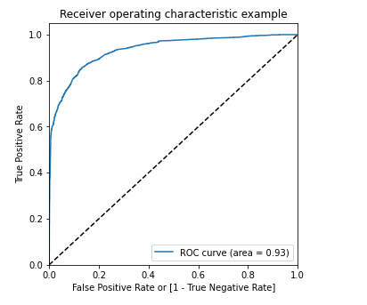
Model Evaluation (Train)

Slide 10
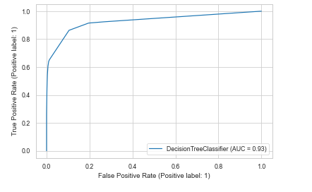
Model Evaluation (Test)

Slide 11
Result
The accuracy, Sensitivity and Specificity values of the training and test set are close to the training set
Accuracy, Sensitivity and Specificity values of the training set are 79%, 82%, and 76% respectively
Accuracy, sensitivity & Specificity values of test are 78%, 81%, 76% respectively
The conversion rate for Train & Test Dataset is 82.7% & 80.8% respectively
We have done the prediction on the test set using cut off threshold from sensitivity & specificity metrics

Slide 12
Conclusion
While we have checked both sensitivity-specificity as well as Precision & recall metrics, we have considered the optimal cut-off based on sensitivity & specificity for calculating the final prediction
Accuracy, Sensitivity & specificity values of the test set are around 78%, 81%,76% which are approximately closer to the Values calculated using the Trained Data Set
Lead Score Calculated for the conversion rate final model on Train & Test dataset is 82.7% &80.8% respectively.
Hence, the Overall Model seems to be Good

Slide 13
Summary
There are a lot of leads generated in the initial stage (top) but only a few of them come out as paying customers from the bottom. In the middle stage, you need to nurture the potential leads well (i.e. educating the leads about the product, constantly communicating etc.) in order to get a higher lead conversion. First, sort out the best prospects from the leads you have generated. 'Total Visits' , 'Total Time Spent on Website' , 'Page Views Per Visit' which contribute most towards the probability of a lead getting converted. Then, You must keep a list of leads handy so that you can inform them about new courses, services, job offers and future higher studies. Monitor each lead carefully so that you can tailor the information you send to them. Carefully provide job offerings, information or courses that suits best according to the interest of the leads. A proper plan to chart the needs of each lead will go a long way to capture the leads as prospects. Focus on converted leads. Hold question-answer sessions with leads to extract the right information you need about them. Make further inquiries and appointments with the leads to determine their intention and mentality to join online courses.

